Slide 1

POORNIMA COLLEGE OF ENGINEERING DEPARTMENT OF ADVANCE COMPUTING
An
INDUSTRIAL TRAINING PRESENTATION
on
Structured Query Language
Name: Ms. Reena Sharma
(Assistant Professor)
Session: 2023-24
Tanishq Maharshi
PCE21CA054

Slide 2
INTRODUCTION:
My industrial training is based on Structure Query Language.
SQL is a program created and formulated in the Relational Database Management System to handle structured data.

Slide 3
TRAINING PLATFORM:
I completed 60 days training with Celebal Technologies in Structured Query Language.
In my training of SQL, I worked on Oracle.
MySQL is a fully managed database service for transactions, real- time analytics across data warehouses and data lakes, and machine learning services, without the complexity, latency, and cost of ETL duplication. It is available on OCI, AWS, and Azure.
Oracle is a relational database management system(RDBMS) that’s used by global enterprises to manage and process data across wide and local area networks.

Slide 4
PREREQUISITES OF THE TRAINING:
To get the internship in Celebal Technologies, you have to give an Online Technical Assessment.
The pattern of question for technical assessment will be computer science MCQs.

Slide 5
DAY WISE SCHEDULE:
The working days of the company is from Monday to Friday.
The working time is from 10:00 A.M. to 07:00 P.M. for the employees.
The internship timing is from 3:30 P.M to 5:00 P.M.

Slide 6
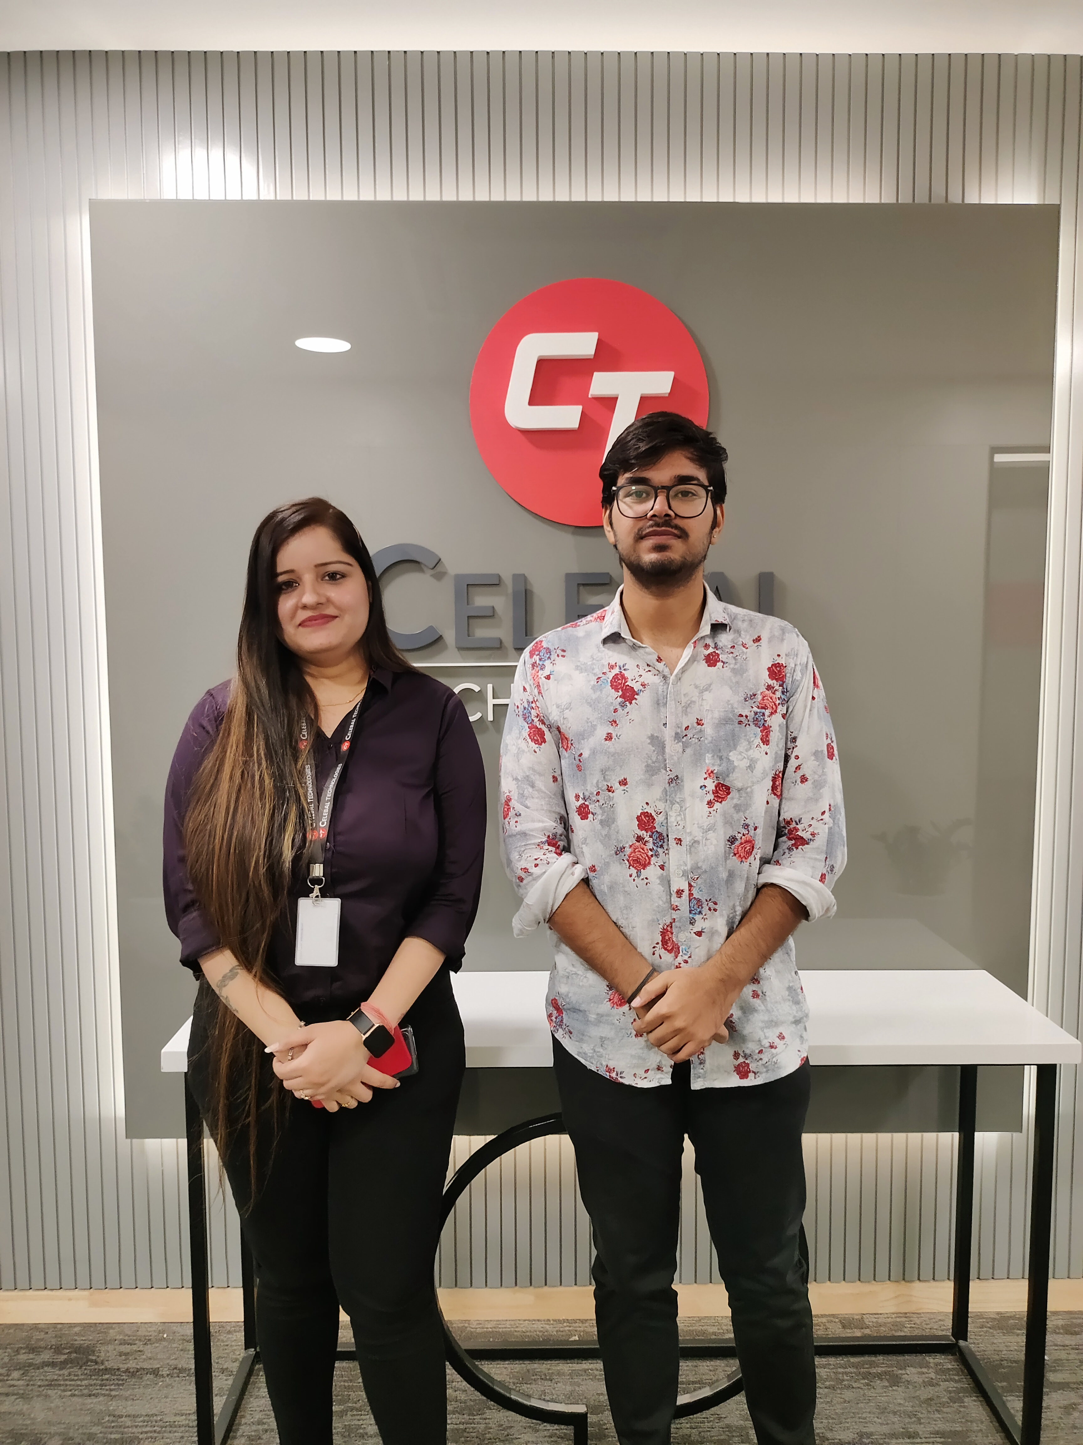

PHOTOS OF WORKPLACE:
Figure 1: Photo with HR Figure 2: Photo at entrance

Slide 7

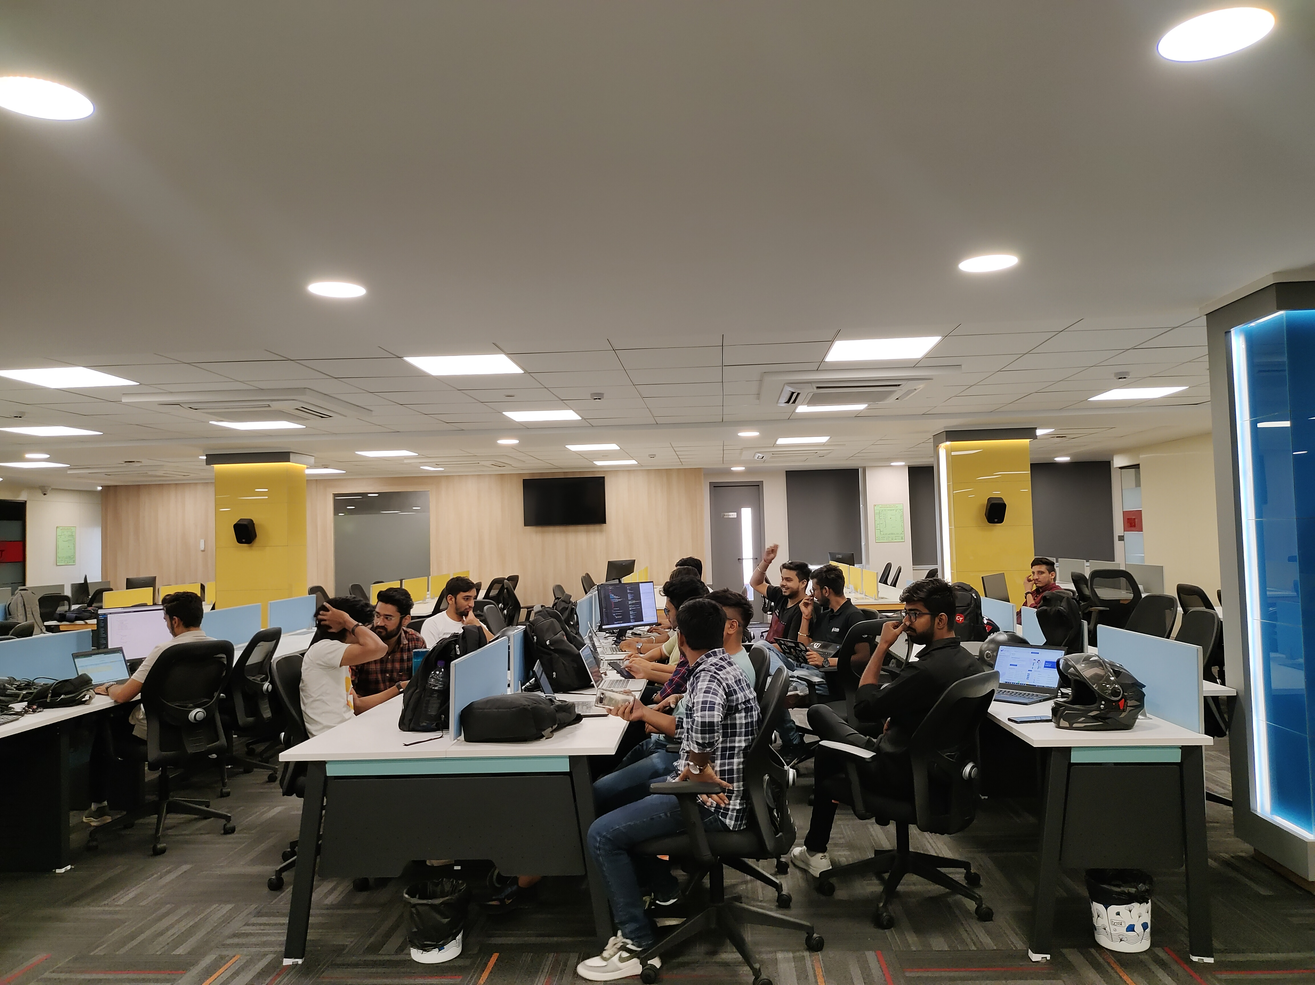
Continue…
Figure 3: Photo with office members Figure 4: Photo at working place

Slide 8
TRAINING COORDINATOR:
My training instructor name is Mr. Prithvi Kumawat.
He is HR Associate.
He has 10 month of experience in Human Resource Associate at Celebal Technologies.

Slide 9
SQL Syntax:
SQL syntax consists of statements that define what operation to perform. It follows a specific structure and includes keywords, expressions, and clauses that form a valid SQL statement.

Slide 10
Data Manipulation Language(DML):
DML commands (SELECT, INSERT, UPDATE, DELETE) allow users to manage and manipulate data in a database. SELECT retrieves data, INSERT adds new records, UPDATE modifies existing records, and DELETE removes records from a table.

Slide 11
Continue…
INSERT Statement
Inserts new rows into a table.
Example:
INSERT INTO Customers (CustomerName, ContactName) VALUES ('Company1', 'John Smith’);
UPDATE Statement
Modifies existing data in a table.
Example:
UPDATE Customers SET ContactName = 'Jane Doe' WHERE CustomerID = 1;

Slide 12
Continue…
SELECT Statement
SELECT statement is used to retrieve data from a database.
Example:
SELECT * FROM Customers;
DELETE Statement
DELETE statement removes records from a table based on specified conditions.
Example:
DELETE FROM Customers WHERE CustomerID = 1;

Slide 13
Data Definition Language(DDL):
DDL commands (CREATE, ALTER, DROP) enable users to define, modify, and delete database structures. CREATE creates new tables, ALTER modifies existing structures, and DROP deletes tables and databases.

Slide 14
Continue…
CREATE Statement
This statement is used to create new database objects, such as tables, views, indexes, and procedures.
Example:
CREATE TABLE employees (
employee_id INT PRIMARY KEY,
first_name VARCHAR(50),
last_name VARCHAR(50),
salary DECIMAL(10, 2)
);

Slide 15
Continue…
ALTER Statement
This statement is used to modify existing database objects, such as adding, modifying, or dropping columns in a table.
Example:
ALTER TABLE employees
ADD COLUMN email VARCHAR(100);

Slide 16
Continue…
DROP Statement
This statement is used to delete existing database objects, such as tables or indexes.
Example:
DROP TABLE employees;

Slide 17
Project:
During my internship period I made a project for practicing.
This project provides a foundation for an online bookstore database management system.
The project can be expand by adding more features such as user authentication, reviews, book categories, and online payment integration.

Slide 18
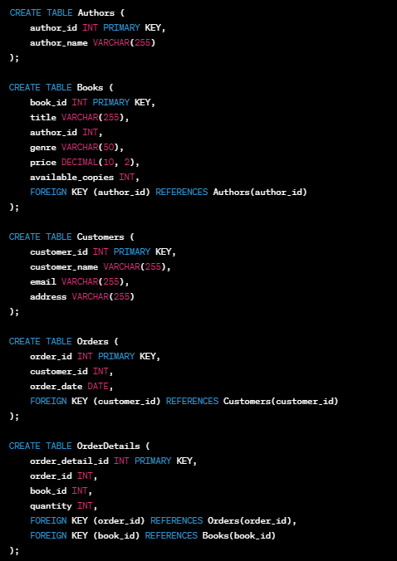
Continue…
Creating Tables:

Slide 19
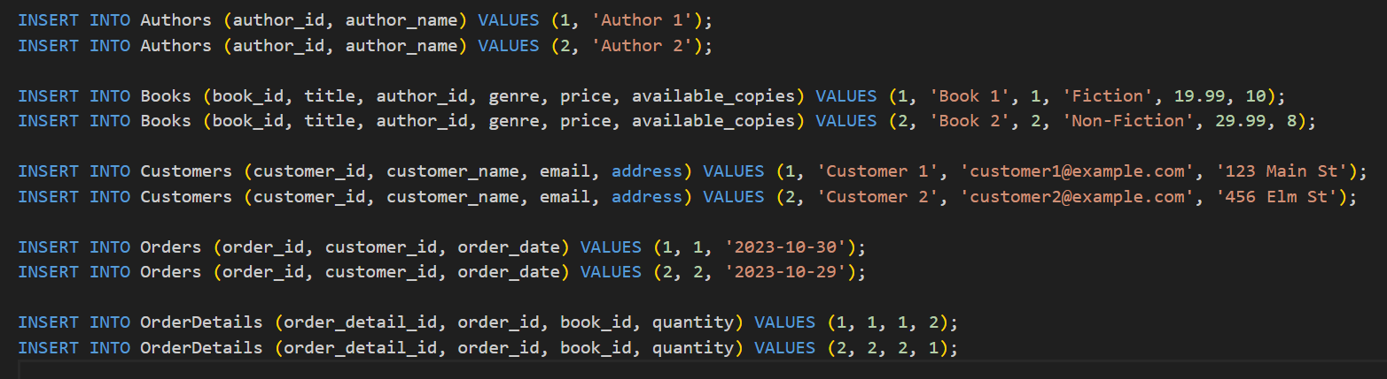
Continue…
Sample Data Insertions:

Slide 20
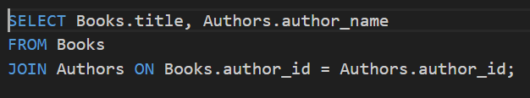
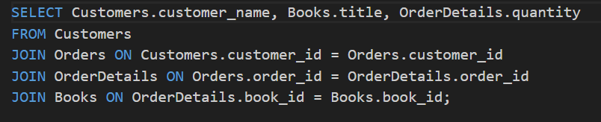
Continue…
Sample Queries:
Retrieve all books along with there authors:
Retrieve customer order along with book details:

Slide 21
Real-World Application of SQL:
E-commerce
SQL can be used to track inventory, process orders, and analyze customer data to improve sales and marketing strategies.
Healthcare
SQL can be used to manage patient data, track medical histories, and analyze treatment outcomes to improve patient care and outcomes.
Finance
SQL can be used to manage financial data, track investments, and analyze market trends to inform investment strategies and decision-making.

Slide 22
Conclusion:
SQL is a powerful language used for managing databases, making it an essential skill for developers, data analysts, and database administrators.
Mastering SQL enables efficient data manipulation, retrieval, and management in various applications.

Slide 23

Any Query?

Slide 24
THANK YOU

